Slide 1
MODULE 2
KNOWLEDGE REPRSENTATION ISSUES
Predicate logic
Representing Knowledge using Rules

Slide 2
Representation and mapping
Two kind of entities
Facts
Representation of facts
Structuring these entities are of two level
Knowledge level
Symbol level

Slide 3
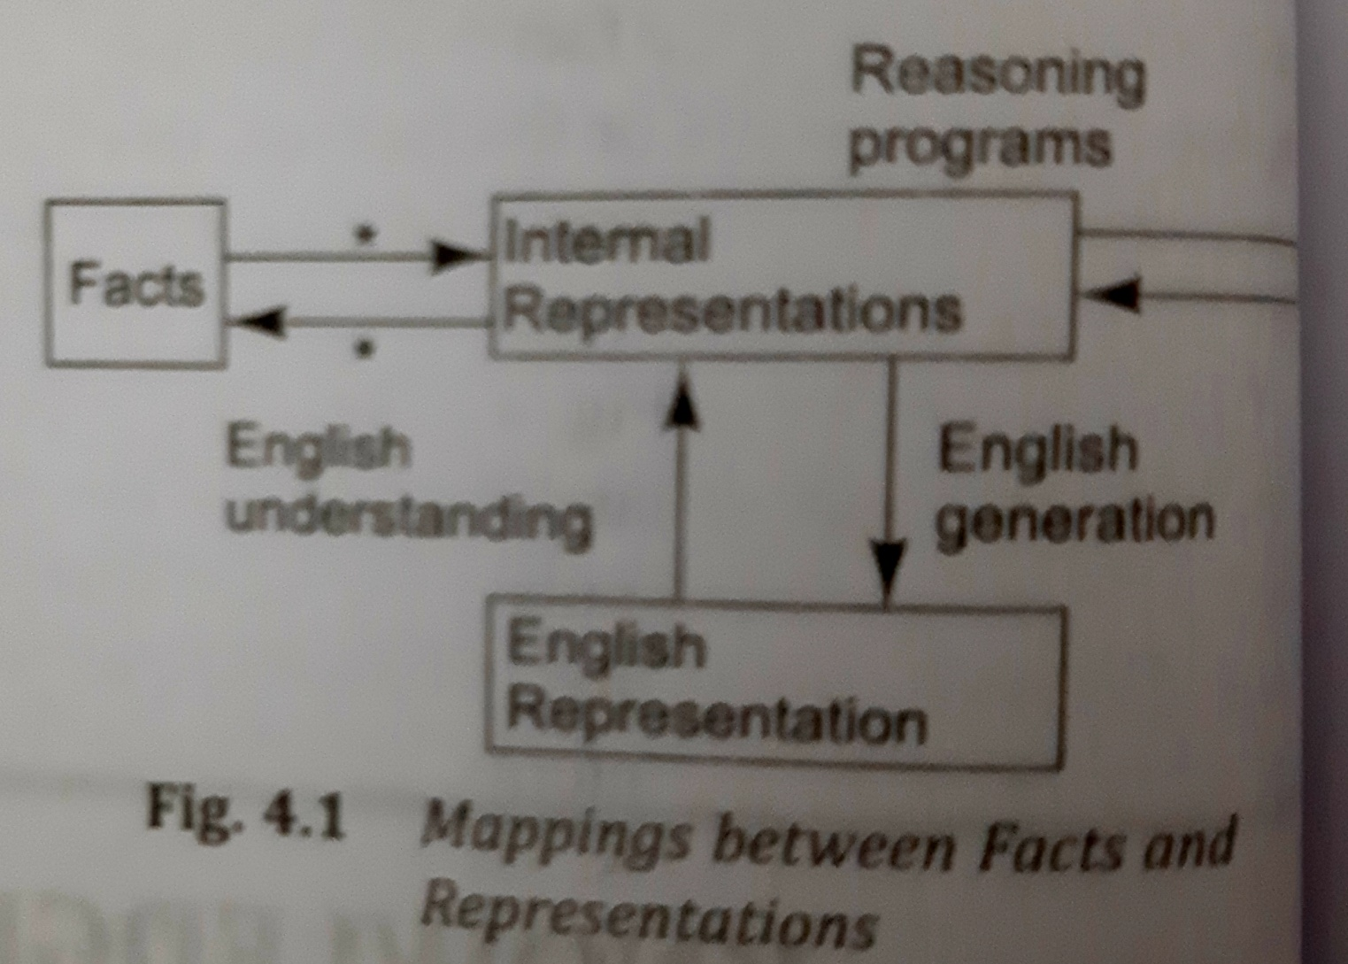
Mapping between facts and Representations

Slide 4
Spot is a dog
Represented in logic: dog(spot)
All dogs have tails
Logic: Ʉx: dog(x)→hastail(x)
Deductive mechanism: hastail(spot)
Use appropriate backward mapping function we could generate
Spot has a tail

Slide 5
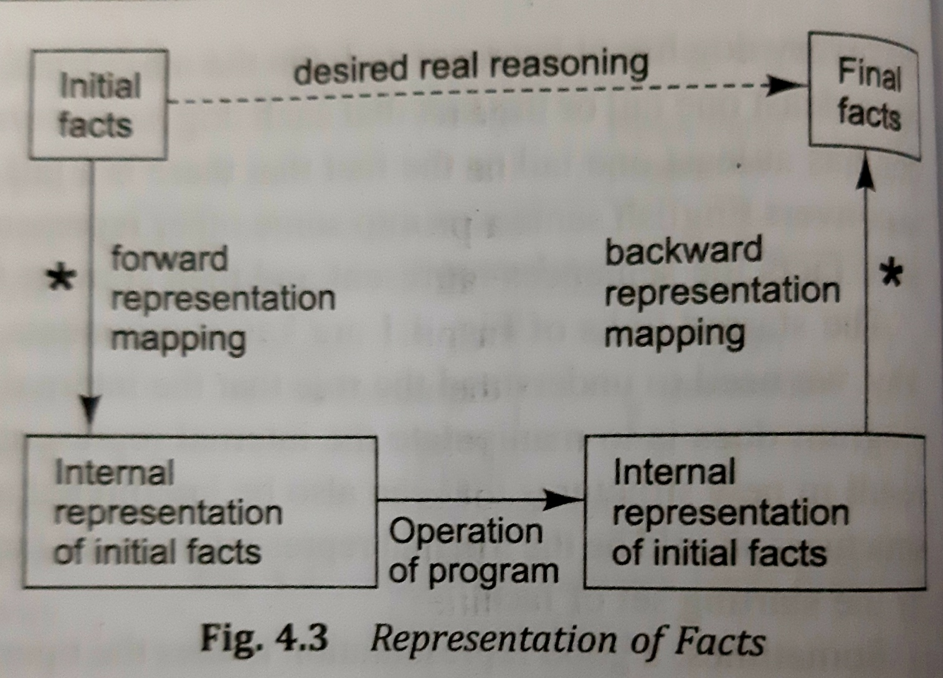

Slide 6
Representation of knowledge in particular domain should possess following properties:
Representational adequacy
Inferential adequacy
Inferential Efficiency
Acquisitional efficiency

Slide 7
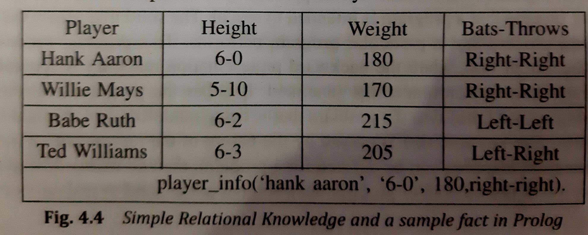
Approaches to knowledge representation
Simple relational knowledge:Set of relations

Slide 8
Inheritable knowledge: Useful form of inference is property inheritance. Object must ne arranged in form of classes and classes arranged in generalization hierarchy.
Attribute isa(class inclusion) and instance(class memebership)
team(Pee wee Reese)=Brooklyn Dodgers
bating_average(Three_Finger_Brown)=.106
height(Pee Wee Reese)=6.1
bats(Three finger Brown)=Right

Slide 9
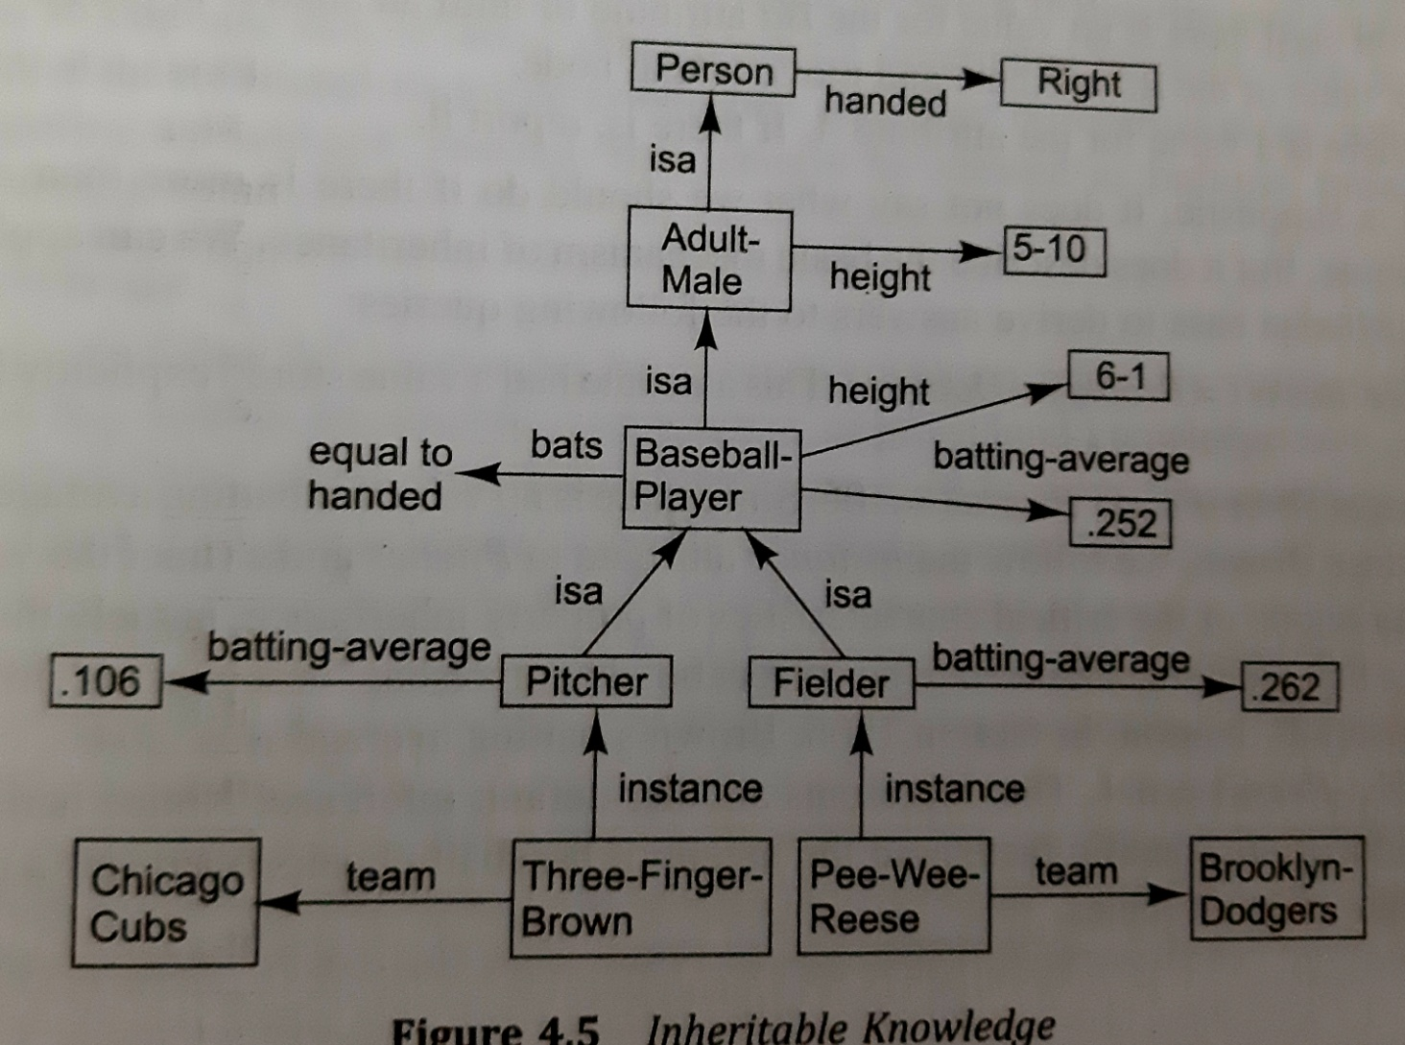

Slide 10
Inferential knowledge: There are many procedures which reason forward and some may backward. One of the most commonly used is resolution which exploits proof by contradiction

Slide 11
Procedural knowledge: It specifies what to do when. It is represented in most common way as code(LISP)
Most commonly used technique is production rules

Slide 12
Issues in knowledge representation
Important attributes: instance,isa
Relationship among attributes
Inverses
Existence in a hierarchy
Techniques for reasoning about values
Single valued attributes
Choosing granularity of representation
Representing set of objects
Finding right structures as needed

Slide 13
Attributes that we use to describe objects are themselves entities that we represent.
Inverses-represent both relationship in single representation that ignores focus
Team(pee wee reeese, brooklyn dodgers)
Use attributes in that focus on single entity but to use them pairs, one the inverse of others
Team=brooklyn dodgers
Team-memebers=pee wee reese

Slide 14
As there are classes as objects and specialized subset of classes, there are attributes and specialization of attributes(constraints on values)
Techniques for reasoning about values
Information about type for a value
Constraints on a value
Rules for computing the value when it is needed(if needed/backward rules)
Rules that describe the action that should be taken if a value ever becomes known(forward rule/if added rules)

Slide 15
Single valued attribute: which is guaranteed to take unique value
Introduce an explicit notation for a temporal interval
Assume only temporal interval that is of interest now. Sow new value is asserted discard the old value
Provide no explicit support.

Slide 16
Choosing granularity of representation
What should be our primitives? Should there be smaller number of lower ones or should be larger number covering range of granularities
John spotted Sue
Spotted(agent(John),object(Sue))
Who spotted Sue?
Did john see Sue?

Slide 17
We add other facts
Spotted(x,y)→saw(x,y)
Alternative to this is spotting is really type of seeing
Saw(agent(john),object(Sue),timespan(briefly))
We broke spotting into two primitives seeing and timespan

Slide 18
High level facts may require lot of storage when broken down into primitives
Substantial work must be done to reduce knowledge into primitive form
It is not clear what primitives must be

Slide 19
Representing set of objects
There are some property true for set but that are not true for individual member of set
Represent set of objects ,if a property is true of all elements of set, then it is more efficient to associate with set rather to associate explicitly with every element of set

Slide 20
2 ways to state definition of set and its elements
Extensional definition-list members
Intensional definition-rule when a particular object evaluated ,return true or false
Used to describe infinite sets
Allow them to depend on parameters that change

Slide 21
Finding the right structure as needed
John went to Steak and Ale last night.He ordered a large rare steak,paid his bill and left.
Did John eat dinner last night?
Selecting initial structure
Revising choice when necessary

Slide 22
Frame problem
Problem of representing the facts that change as well as those that donot change is known as frame problem
To support this kind of reasoning, we have explicit set of axioms called frame axioms, which describe all the things that donot change when a particular operator is applied
color(x,y,s1)ᴧmove(x,s1,S2)→color(x,y,S2)
State variable

Slide 23
Representing simple facts in logic
It is raining
RAINING
It is sunny
SUNNY
It is windy
WINDY
If it is raining,then it is not sunny
RAINING→¬SUNNY

Slide 24
Socrates is a man
SOCRATESMAN
Plato is a man
PLATOMAN
Predicates applied to argument
MAN(SOCRATES)
MAN(PLATO)
All men are mortal
MORTALMAN
Predicate logic is semidecidable

Slide 25
Marcus was a man
Marcus was a Pompeian
All Pompeians were Romans
Caesar was a ruler
All Romans were either loyal to Caesar or hated him
Everyone is loyal to someone
People only try to assassinate rulers they are not loyal to
Marcus tried to assassinate Caesar

Slide 26
man(Marcus)
pompeian(Marcus)
Ʉx:Pompeian(x)→Roman(x)
ruler(Caesar)
Ʉx:Roman(x)→loyalto(x,Caesar)ᴠ hate(x,Caesar)
Ʉx:→y:loyalto(x,y)
Ʉx:Ʉy:person(x)ᴧruler(y)ᴧ tryassisassinate(x,y)→¬loyalto(x,y)
tryassassiante(Marcus,Caesar)

Slide 27
Was Marcus loyal to Caesar?
Formal proof reasoning backward from desired goal:¬ loyalto(Marcus,Caesar)
¬ loyalto(Marcus,Caesar)
↑(7)
Person(Marcus)ᴧruler(Caesar)ᴧtryassassinate(Marc us,Caesar)
↑(4)
Person(Marcus)ᴧtryassassinate(Marcus,Caesar)
↑(8)
Person(Marcus)
9.All men are people
Ʉx:man(x)→person(x)

Slide 28
¬ loyalto(Marcus,Caesar)
↑(7)
Person(Marcus)ᴧruler(Caesar)ᴧtryassassinate( Marcus,Caesar)
↑(4)
Person(Marcus)ᴧtryassassinate(Marcus
,Caesa r)
↑(8)
Person(Marcus)(9)

Slide 29
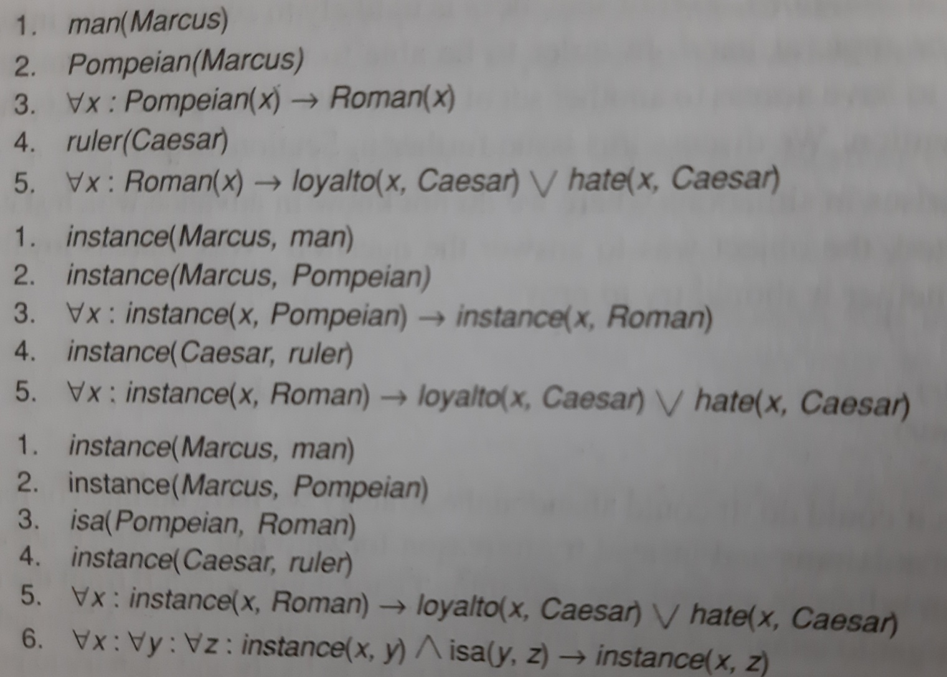
Representing instance and isa relationships

Slide 30
Computable functions and predicates
Gt(1,0) lt(0,1)
Gt(2,1) (lt(1,2)
Gt(3,2) lt(2,3)
… …
… …

Slide 31
FACTS
Marcus was a man
Man(Marcus)
Marcus was Pompeian
Pompeian(Marcus)
Marcus was born in 40 A.D
Born(Marcus,40)
All men are mortal
Ʉx:man(x)→mortal(x)
All Pompeian died when volcano erupted in 79 A.D
erupted(volacano,79)ᴧɄx:[Pompeian(x)—>died(x,79)]
No mortal lives longer than 150 years
Ʉx:Ʉt1:Ʉt2:mortal(x)ᴧborn(x,t1)ᴧ
gt(t2-t1,150)→dead(x,t2)
It is now 1991 A.D
now=1991

Slide 32
Is Marcus alive?
Killed by volcano
More than 150 years
Alive means not dead
Ʉx:Ʉt:[alive(x,t)→¬dead(x,t)]˄[¬dead(x,t)→
alive(x,t)
If someone dies he is dead at all later times
Ʉx:Ʉt1:Ʉt2:died(x,t1)ᴧgt(t2,t1)→
dead(x,t2)

Slide 33
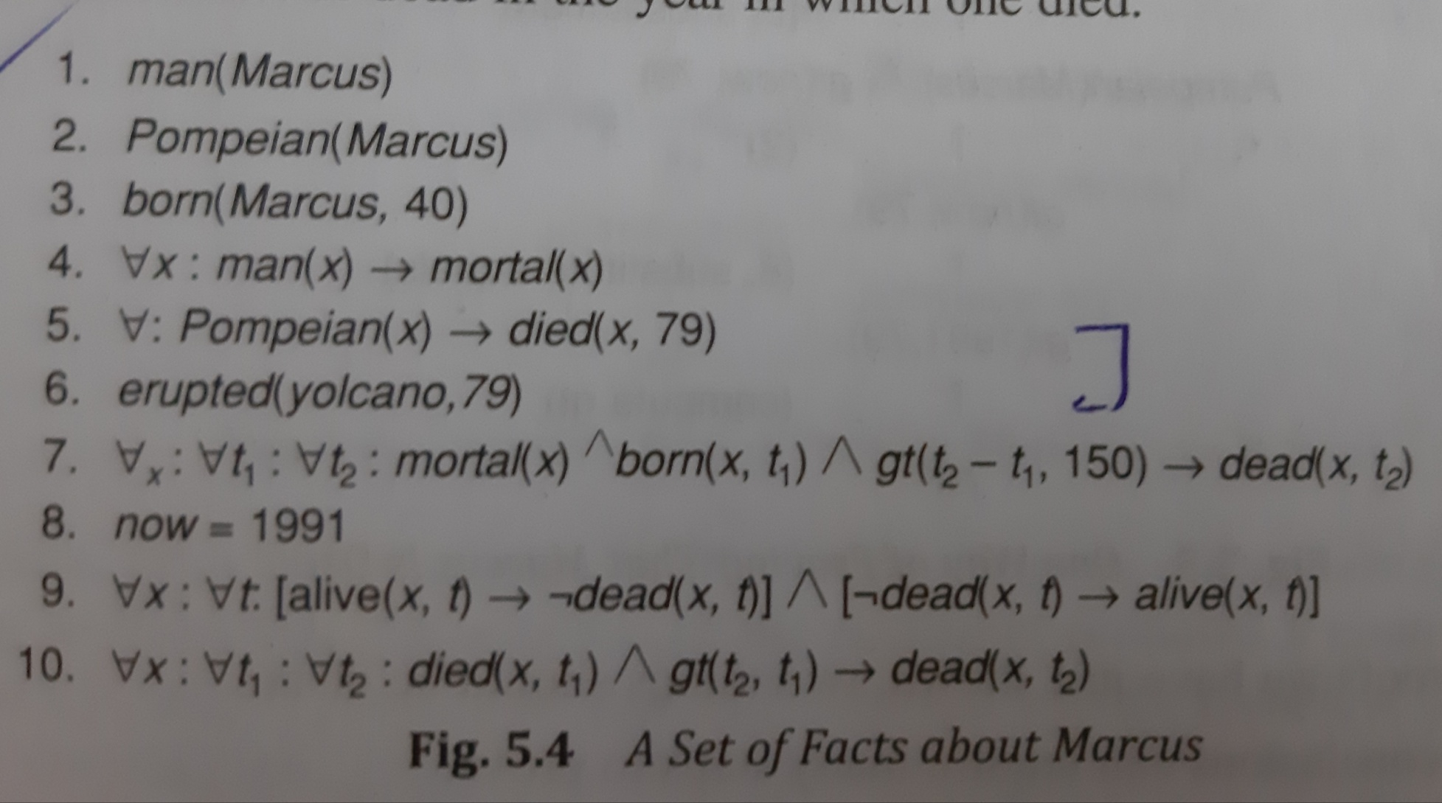

Slide 34
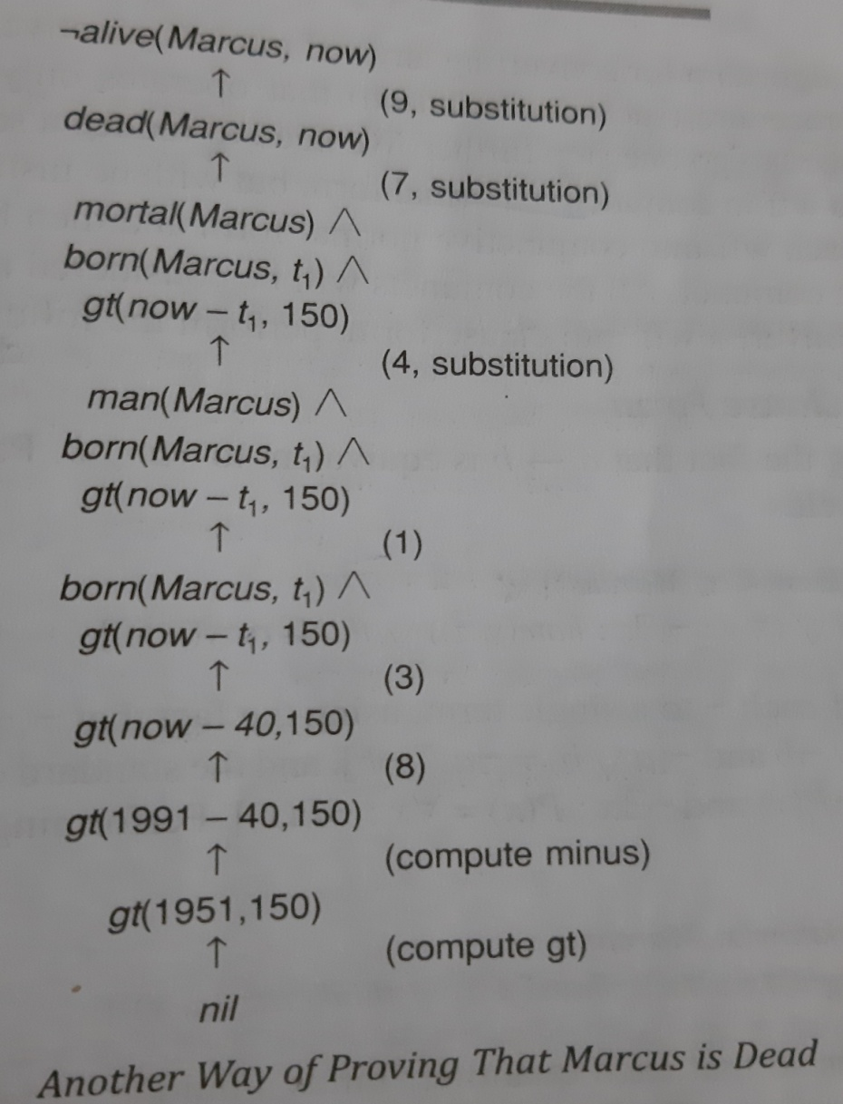

Slide 35
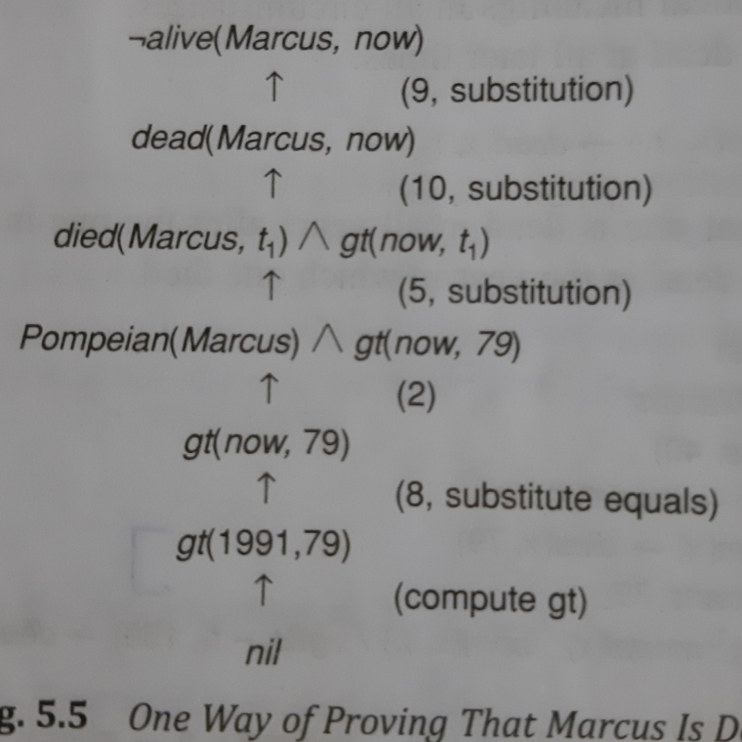

Slide 36
Born(Marcus,t1)
Gt(now-t1,150)
Even very simple conclusions can require many steps to prove
Variety of processes such as matching, substitution are involved in the production of proof

Slide 37
Resolution
Resolution produces proof by refutation. To prove a statement resolution attempts to show that the negation of the statement produces contradiction with known statements
It operates on statement that have been converted to a very convenient standard form

Slide 38
Conjunctive normal form(CNF)
Flatter(less embedding of components)
Quantifiers were separated from rest of the formula
All Roman who know Marcus either hate Caesar or think anyone who hates anyone is crazy
Ʉx:[Roman(x)ᴧknow(x,Marcus)]→[hate(x,Caesar)ᴠ(Ʉ y :Эz hate(y,z)→thinkcrazy(x,y))]
CNF: ¬Roman(x) ᴧ¬know(x,Marcus)ᴠhate(x,Caesar)ᴠ ¬hate(y,z)ᴠthinkcrazy(x,z)

Slide 39
All Roman who know Marcus either hate Caesar or think anyone who hates anyone is crazy
Ʉx:[Roman(x)ᴧknow(x,Marcus)]→[hate(x,Caesar)ᴠ(Ʉ y :Эz: hate(y,z)→thinkcrazy(x,y))]
CNF:
¬Roman(x)ᴧ¬know(x,Marcus)ᴠhate(x,Caesar)ᴠ ¬hate(y,z)ᴠthinkcrazy(x,z)

Slide 40
Algorithm:convert to clause form
1.Eliminate→,using the fact a→b is equivalent to ¬aᴠb
Ʉx:¬[Roman(x)ᴧknow(x,Marcus)]ᴠ[hate(x,Caesar)ᴠ(Ʉ y :¬(Эz hate(y,z))ᴠthinkcrazy(x,y))]
2.Reduce the scope of each ¬to a single term using the fact ¬(¬p)=p,de Morgans law and standard correspondences between quantifier
Ʉx:[¬Roman(x)ᴠ¬know(x,Marcus)]ᴠ[hate(x,Caesar)ᴠ(Ʉ y :Ʉ z:¬ hate(y,z)ᴠthinkcrazy(x,y))]

Slide 41
3.Standardize the variable so that each quantifier binds to unique variable
Ʉx:P(x)ᴠɄx:Q(x)
Would be converted to
Ʉx:P(x)ᴠɄy:Q(y)
4.Move all quantifiers to the left of the formula without changing their relative order
Ʉx: Ʉy :Ʉz:
[¬Roman(x)ᴠ¬know(x,Marcus)]ᴠ[hate(x,Caesar)ᴠ(¬ hate(y,z)ᴠthinkcrazy(x,y))]
Formula now is known as prenex normal form

Slide 42
5.Eliminate existential quantifier
Эy:President(y)
Can be transformed into formula
President(S1)
6.Drop the prefix,all remaining variables are universally quantified
[¬Roman(x)ᴠ¬know(x,Marcus)]ᴠ[hate(x,Caesar)ᴠ(¬ hate(y,z)ᴠthinkcrazy(x,y))]

Slide 43
7.Convert the matrix into conjunction of disjuncts,but our example has no ands
¬Roman(x)ᴠ¬know(x,Marcus)ᴠ[hate(x,Caesar)ᴠ¬ hate(y,z)ᴠthinkcrazy(x,y)
8.Create a separate clause corresponding to each conjunct
9.Standardize apart the variables in set of clauses generated in step 8

Slide 44
Basis of Resolution
Resolution operates by taking two clauses that each contain the same literal(ex-winter).
The literal must occur in positive form in one clause and in negative form in the other.
The resolvent is obtained by combining all of the literals of two parent clauses except the ones that cancel

Slide 45
Example→ winter ᴠ summer
¬winter ᴠ cold
We can deduce
summer ᴠ cold
If the clause that is produced is empty clause, then contradiction has been found
Example→ winter
¬winter
This example produce a empty clause
Predicate logic→ Herbrands theorem

Slide 46
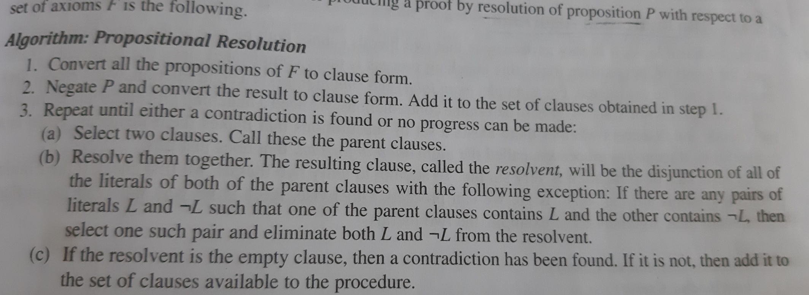
Resolution in propositional logic
Algorithm

Slide 47
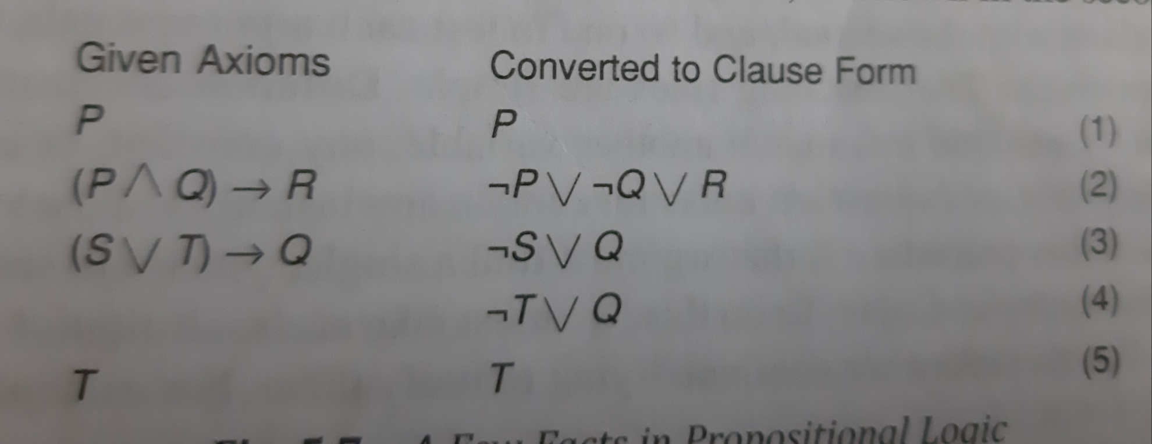
Facts in propositional logic

Slide 48
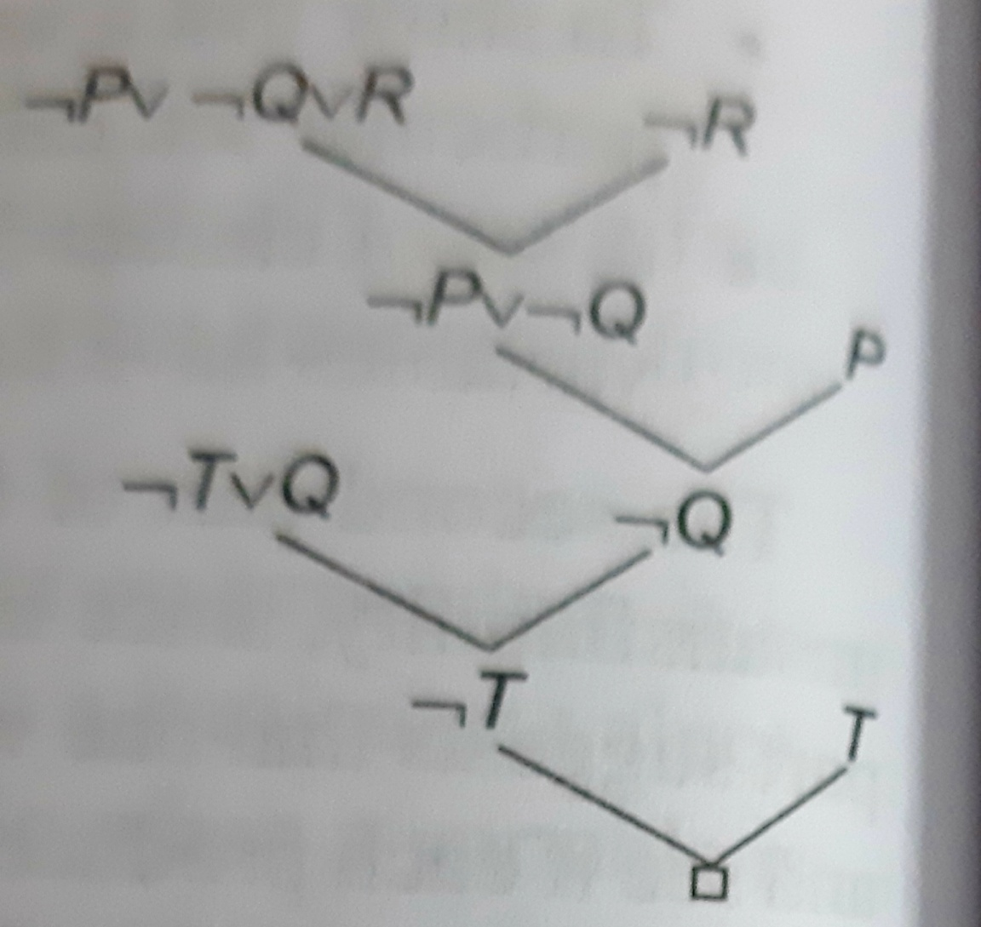
Resolution in propositional logic

Slide 49
Unification Algorithm
In predicate logic ,matching process is complicated since arguments of the predicates must be considered
Ex1: man(john)
¬man(john) is a contradiction
Ex2: man(john)
¬man(spot) is not a contradiction

Slide 50
P(x,x)
P(y,z)
Substitute y for x,i.e y/x
P(y,y)
P(y,z)
Composition of two substitutions (z/y)(y/x)

Slide 51
Example: hate(x,y)
hate(Marcus,z)
Can be unified with any of the following substitutions
(Marcus/x, z/y)
(Marcus/x, y/z)
(Marcus/x, Caeser/y, Caesar/z)
(Marcus/x, Polonius/y, Polonius/z)

Slide 52
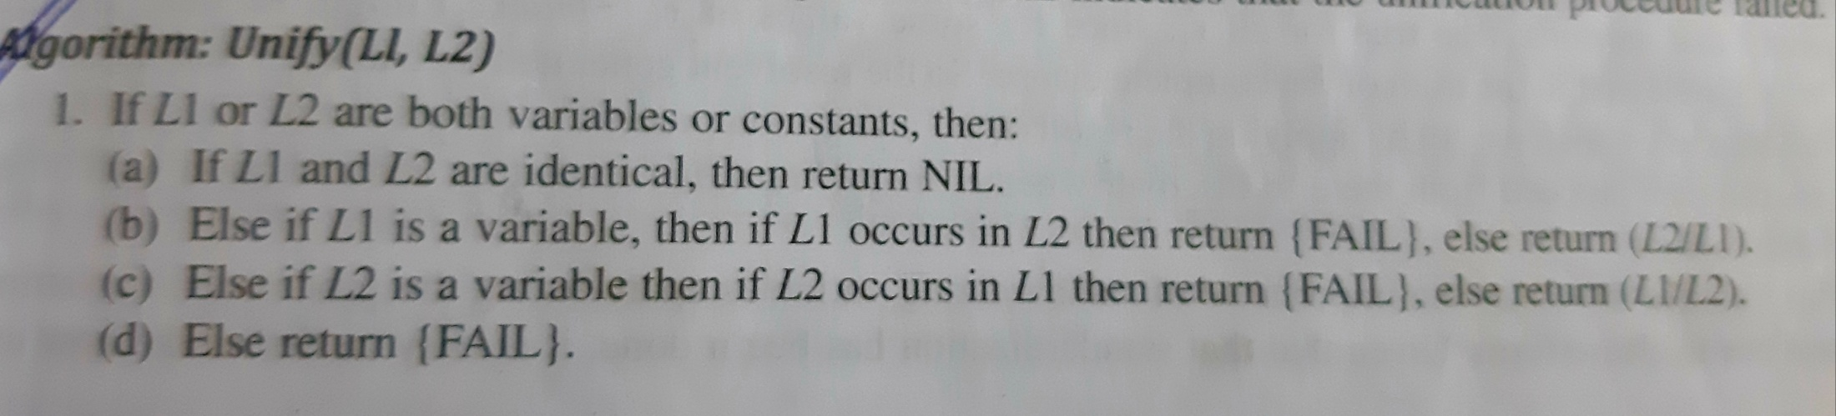
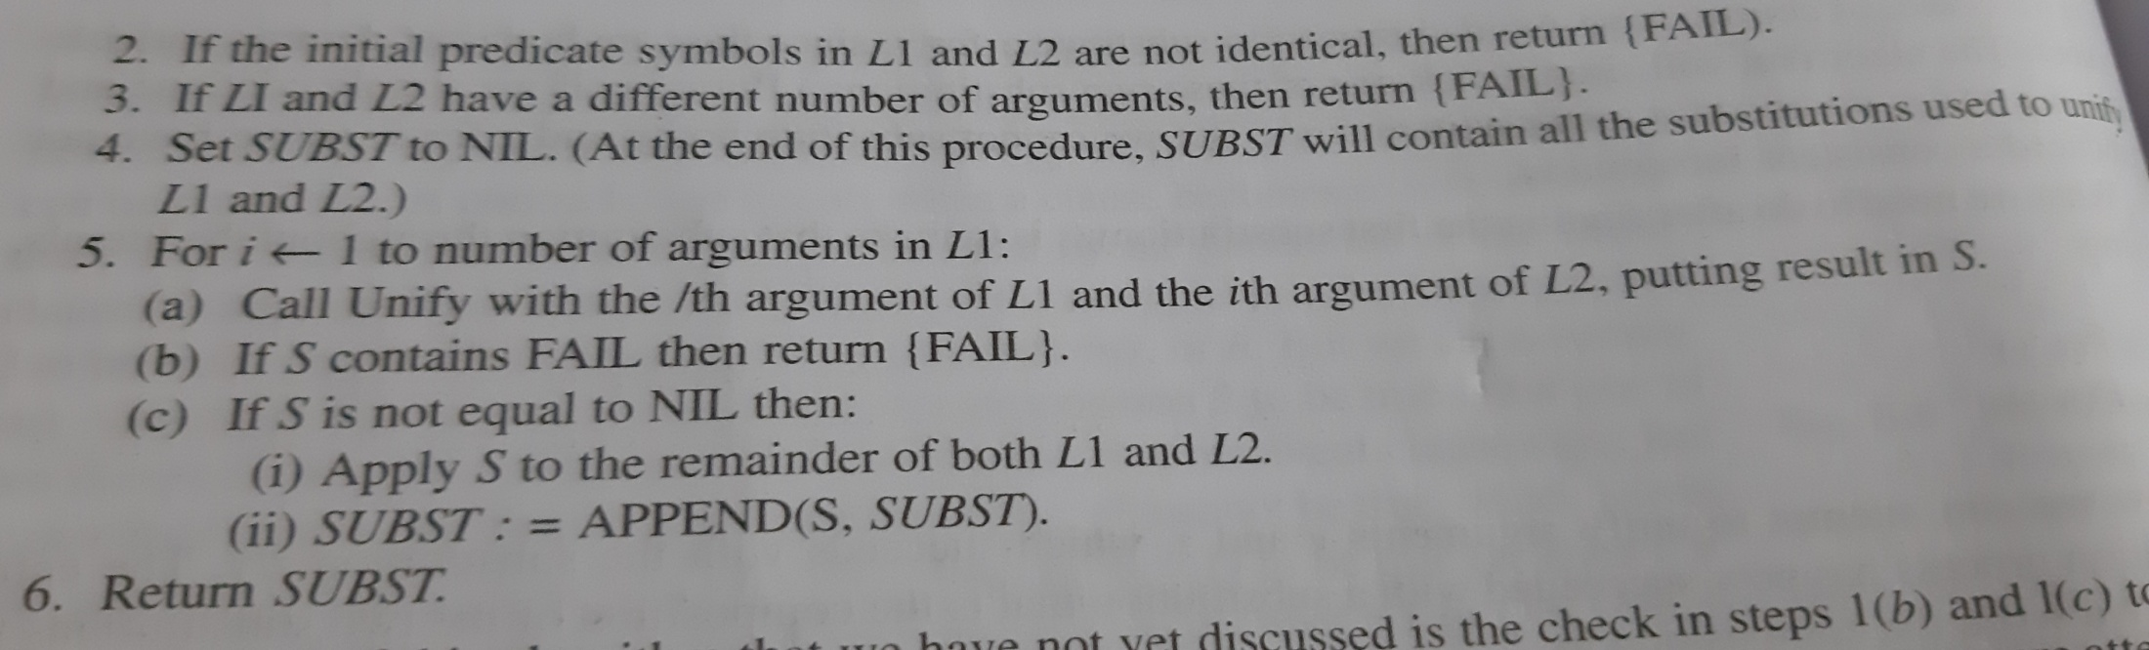
Algorithm:Unify(L1,L2)

Slide 53
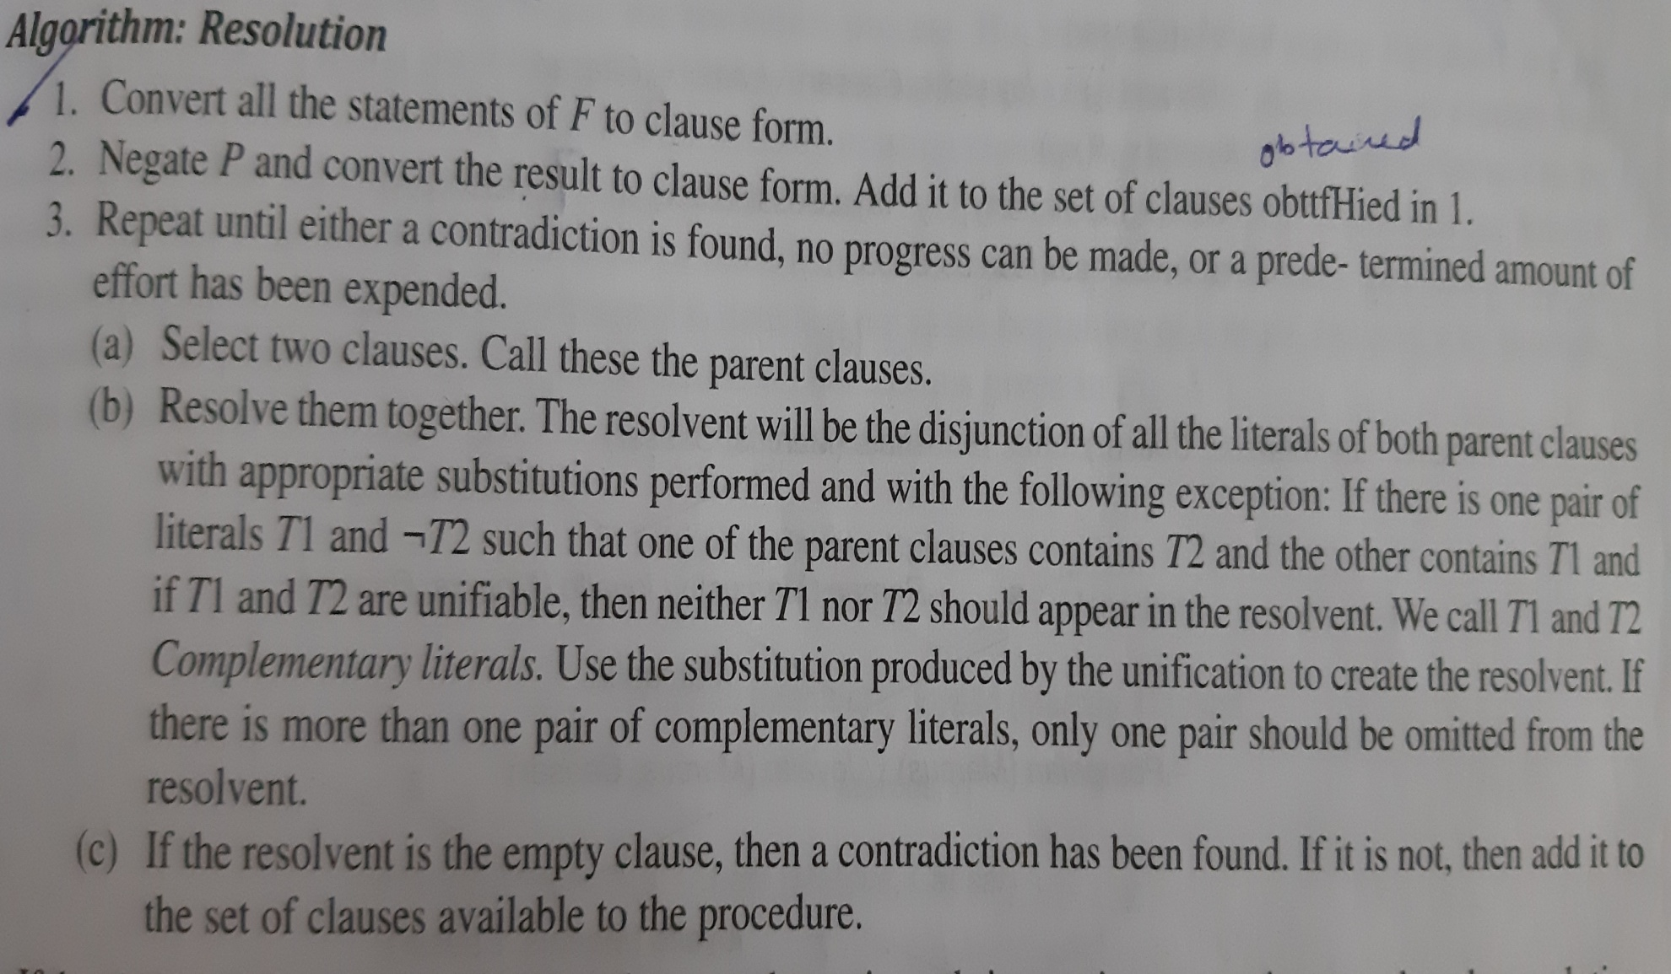
Resolution in predicate logic

Slide 54
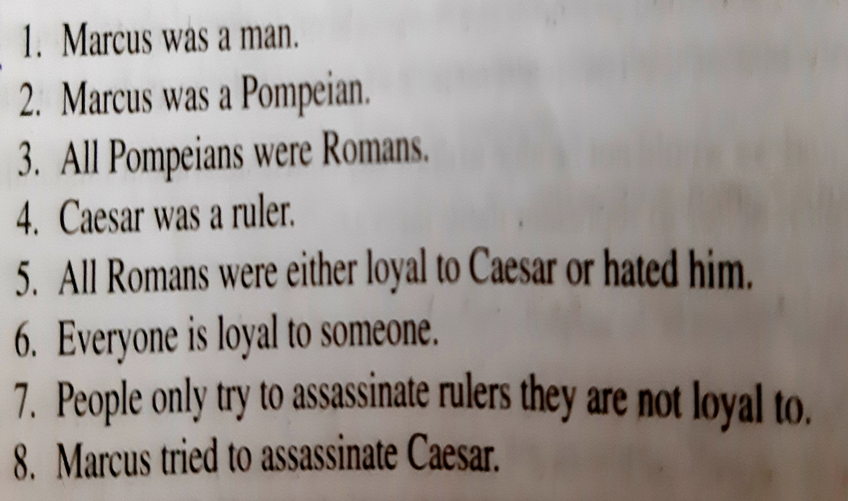

Slide 55
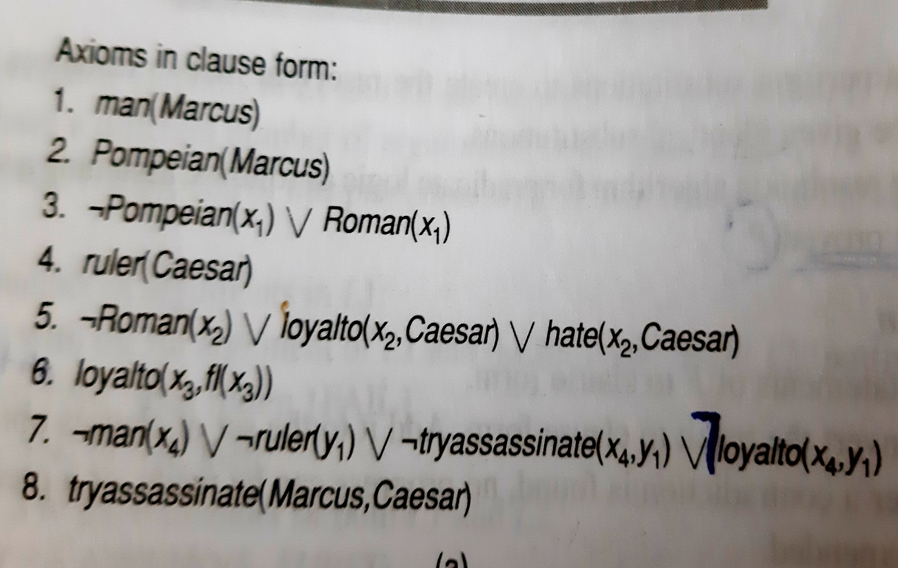

Slide 56
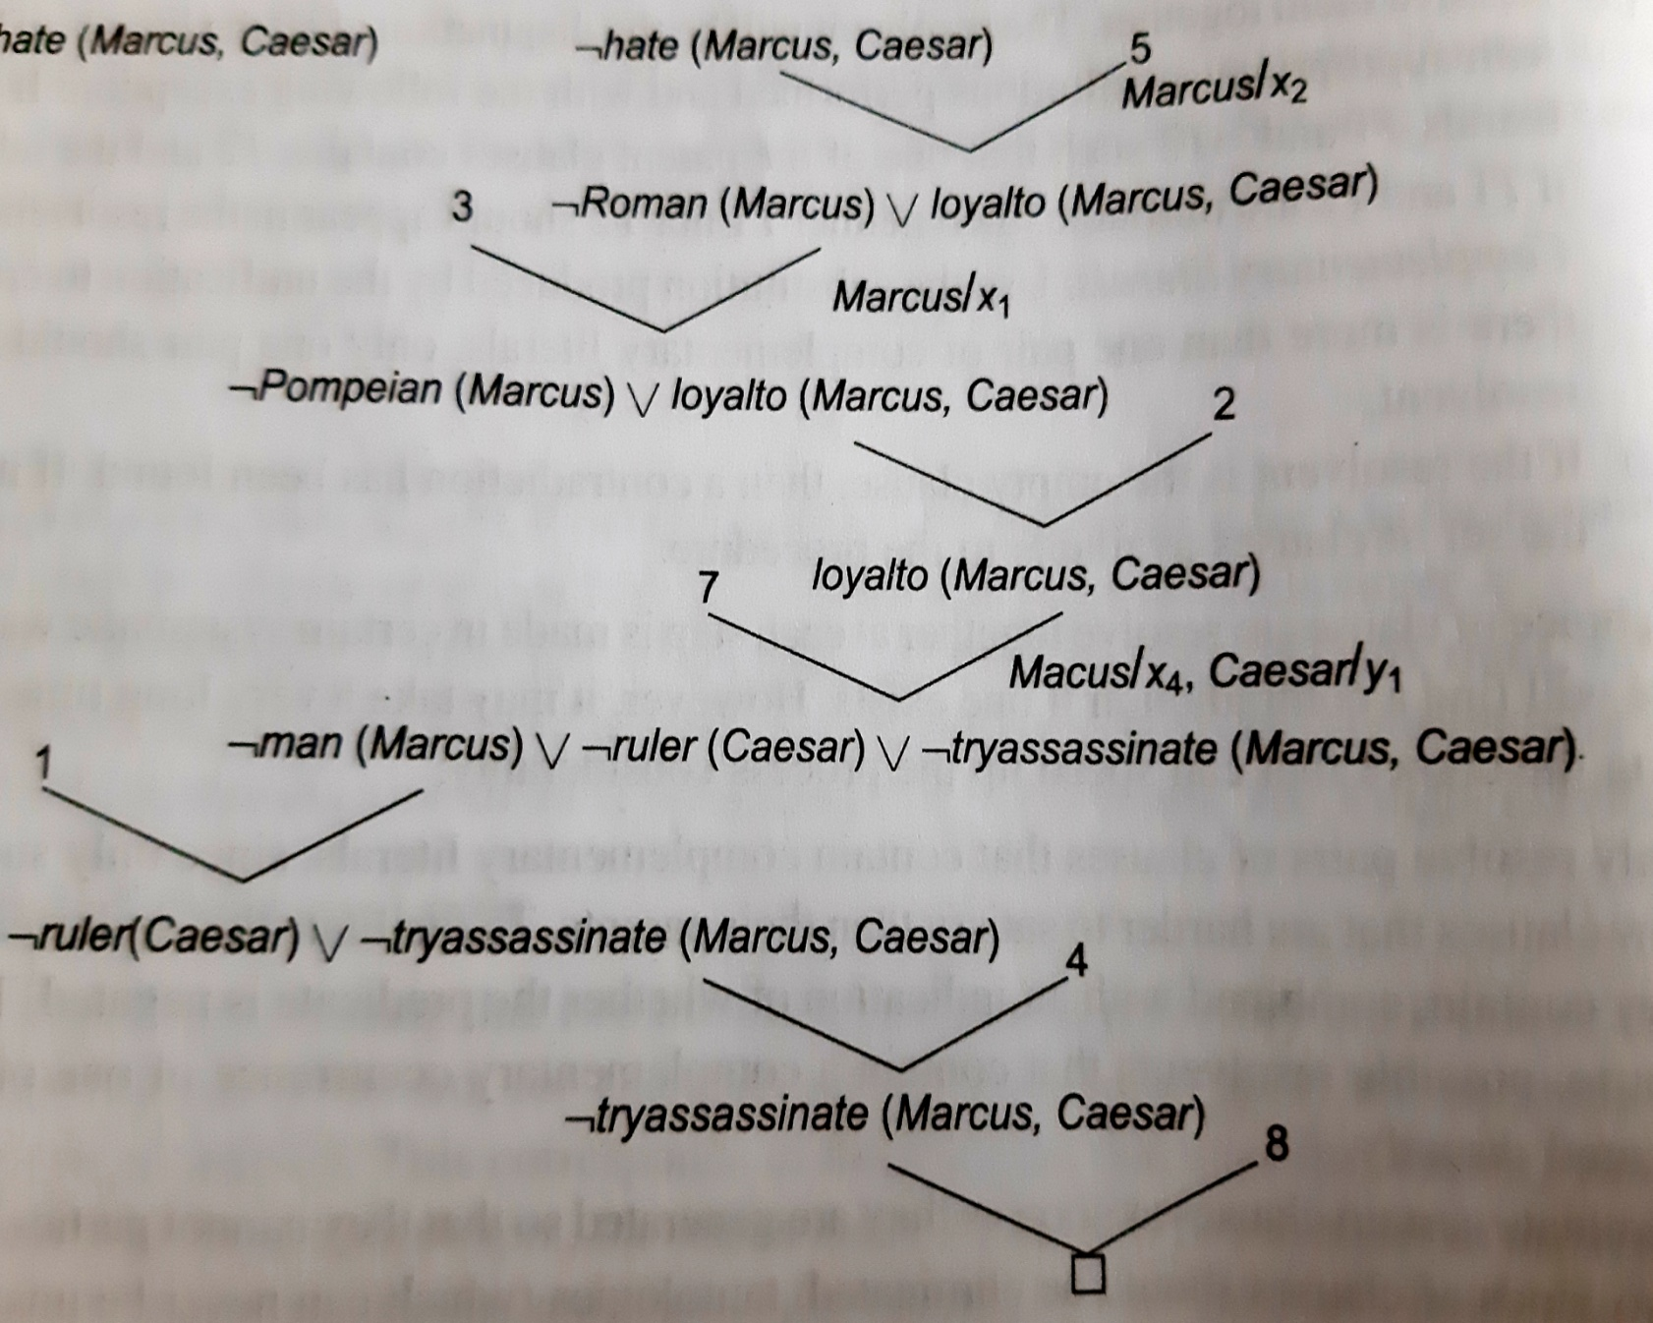

Slide 57
Strategies
1.Only resolve pairs of clauses that contain complementary literals
2.Eliminate certain clauses as soon as they are generated as they cannot participate in later resolutions.1→tauatologies 2→clauses that subsumed by other clauses(PᴠQ)
3.Whenever possible resolve either with one of clause that is part of statement we are trying to refute or clause generated by a resolution with such a clause
4.Whenever possible resolve the clauses that have single literal

Slide 58
Two ways of generating new clause in addition to resolution rule
Substitution of one value to another to which it is equal
Reduction of computable predicates.

Slide 59
Need to try several substitutions
Hate(Marcus,Paulus)
Hate(Marcus,Julian)
Hate(Marcus,Caesar)
Suppose we want prove “Marcus hates some ruler”
Prove:Эx:hate(Marcus,x) ᴧruler(x)
Negate:¬Эx:hate(Marcus,x) ᴧruler(x)
Clause:¬hate(Marcus,x) ᴠ¬ruler(x)

Slide 60
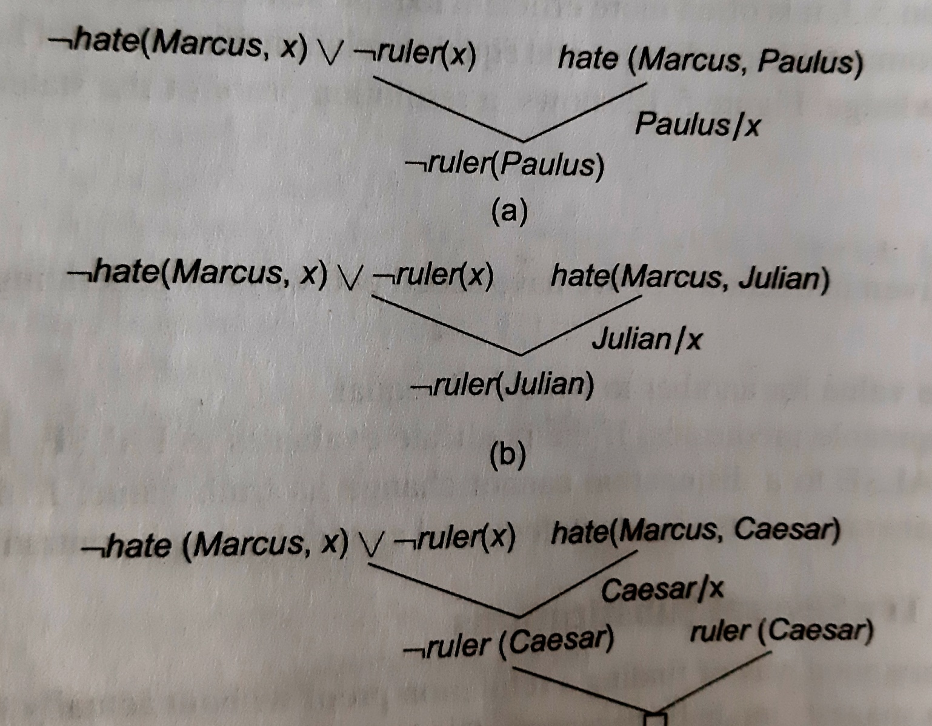

Slide 61
Question Answering
Resolution can be used to answer fill in the blank questions such as “When did Marcus die?” or ”Who tried to assassinate a ruler?”
Answering these questions involves finding a known statement that matches the term given in the question
Ex:When did Marcus die?
Died(Marcus,??) where?? is filled by some particular year.So we prove died(Marcus,79) and respond with the answer 79

Slide 62
Natuaral Deduction
Disadvantages of resolution
Heuristic information contained in original statement would be lost
Ex:All the judges who are not crooked are well educated.
Logic form Ʉx:judge(x)ᴧ¬crooked(x)→educated(x)
Clause form¬judge(x)ᴠcrooked(x)ᴠeducated(x)
Another problem of the Use of resolution of theorem prover is that people donot think in resolution

Slide 63
We are forced to look for a way of machine theorem proving that corresponds more closely to the process used in human theorem proving. We call this as Natural Deduction
Natural Deduction describe mélange of techniques used in combination to solve problems that are not tractable by any method alone.
Arrange by objects involved in predicates
Rewrite the rules, where implication can be exploited in proof

Slide 64
Representing Knowledge using Rules

Slide 65
Representing knowledge using rules
Procedural versus Declarative Knowledge
Declarative representation →knowledge is specified, but the use to which is not given
Procedural representation →control information necessary to use knowledge is embedded in knowledge itself

Slide 66
Example1
Man(Marcus)
Man(Caesar)
Person(Cleopatra)
Ʉx:man(x)→person(x)
Answer the question Эy:person(y)
Example2
Man(Marcus)
Man(Caesar)
Ʉx:man(x)→person(x)
Person(Cleopatra)

Slide 67
Logic Programming
PROLOG pgm is series of logical assertions ,each of which is horn clause
Horn clause is a clause that has atmost one positive literal.p,¬pᴠq,p→q

Slide 68
Syntactic difference between Logic and PROLOG
In logic variables are explicitly quantified. In PROLOG implicitly by having all variables as upper case and constants as lower case
In Logic explicit symbols for (ᴧ) and and (ᴠ) or.In PROLOG there is an explicit symbol for and(,) but there is none for or, it is represented as list of alternatives
In Logic implication p→q.In PROLOG same is written as backward q:-p

Slide 69
PROLOG P(X):-Q(X,Y)
Suppose the problem given is to find value of X that satisfies the predicate apartmentpet(X).We state this goal in PROLG as
?-apartmentpet(X)

Slide 70
Logical negation cannot be represented in pure PROLOG .Instead represented as lack of assertion.
Ʉx:dog(x)→¬cat(x)
It uses as strategy called negation as failure
?-cat(fluffy)
Closed world assumption

Slide 71
Forward versus Backward Chaining
Forward from start states
Backward from goal states
Example:8 puzzle
Reason forward from the initial states
Reason backward from goal states

Slide 72
Factors influence whether to reason forward or backward
Are there more possible start states or goal states(move form smaller to larger set of states)
In which direction is the branching factor?(lower branching factor)
Will the program be asked to justify its reasoning process to a user?(way the user think)
What kind of event is going to trigger a problem solving episode?(arrival of new fact is forward reasoning ,if it is query reason backward)

Slide 73
Same set of rules can be used for both forward and backward reasoning, but define two classes of rules each of which encodes a particular kind of knowledge
1.Forward rules which encode knowledge how to respond to certain input configuration
2.Backward rules which encode knowledge about how to achieve particular goals

Slide 74
Backward chaining rule system→ goal directed problem solver. Ex:query system
Forward chaining rule system->directed by incoming data.Ex:OPS5
Combining Forward and Backward Reasoning

Slide 75
Matching
1.Indexing(Chess)
2.Matching with variables(RETE)
Temporal nature of data
Structural similarities in rules
Persistence of variable binding consistency
3.Complex and approximate matching
4.Conflict Resolution
Preference based on rule that matched
Preference based on objects that matched
Preference based on action that matched rule would perform

Slide 76
Control Knowledge
Knowledge about which states are more preferable to others
Knowledge about which rule to apply in given situation
Knowledge about the order in which to pursue subgoals
Knowledge about useful sequence of rules to apply

Slide 77
Two AI system that represent their control knowledge with rules
SOAR
PRODIGY

